Slide 1
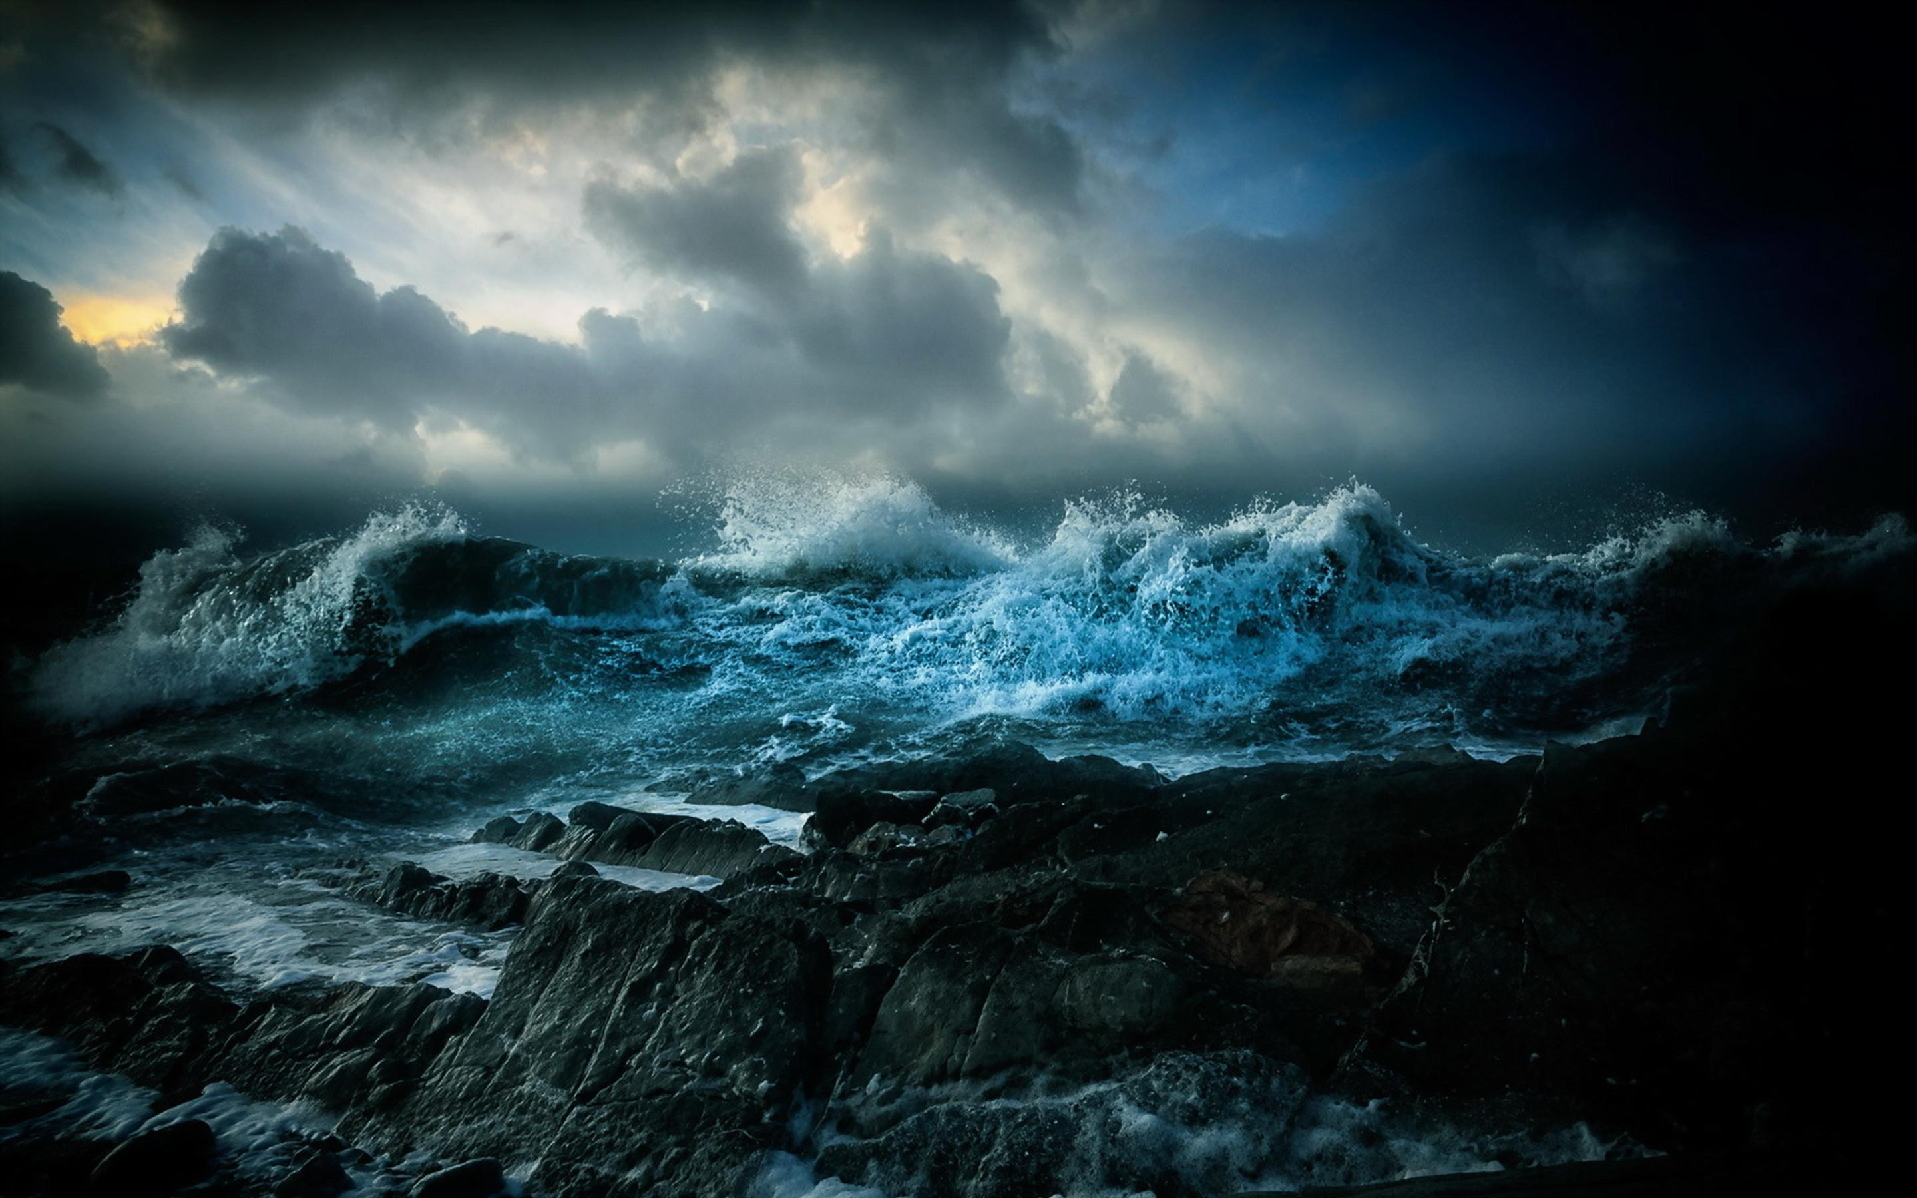
Psalm 124
What a Difference the LORD Makes
Sunday, September 10, 2023

Slide 2
Psalm 124
A Song of Ascents, of David.
1 "Had it not been the LORD who was on our side," Let Israel now say, 2 "Had it not been the LORD who was on our side When men rose up against us, 3 Then they would have swallowed us alive, When their anger was kindled against us; 4 Then the waters would have engulfed us, The stream would have swept over our soul; 5 Then the raging waters would have swept over our soul." 6 Blessed be the LORD, Who has not given us to be torn by their teeth. 7 Our soul has escaped as a bird out of the snare of the trapper; The snare is broken and we have escaped. 8 Our help is in the name of the LORD, Who made heaven and earth.

Slide 3
Proverbs 21:31
The horse is prepared for the day of battle, But victory belongs to the LORD.

Slide 4
Life without the LORD on your side ^{(124:1-5)}
1 "Had it not been the LORD who was on our side," Let Israel now say, 2 "Had it not been the LORD who was on our side When men rose up against us, 3 Then they would have swallowed us alive, When their anger was kindled against us; 4 Then the waters would have engulfed us, The stream would have swept over our soul; 5 Then the raging waters would have swept over our soul."

Slide 5
Exodus 2:23-25
23... the sons of Israel sighed because of the bondage, and they cried out; and their cry for help because of their bondage rose up to God. 24 So God heard their groaning; and God remembered His covenant with Abraham, Isaac, and Jacob. 25 God saw the sons of Israel, and God took notice of them.

Slide 6
Exodus 14:19-22
19 The angel of God, who had been going before the camp of Israel, moved and went behind them; and the pillar of cloud moved from before them and stood behind them. 20 So it came between the camp of Egypt and the camp of Israel; and there was the cloud along with the darkness, yet it gave light at night. Thus the one did not come near the other all night. 21 Then Moses stretched out his hand over the sea; and the LORD swept the sea back by a strong east wind all night and turned the sea Into dry land, so the waters were divided. 22 The sons of Israel went through the midst of the sea on the dry land, and the waters were like a wall to them on their right hand and on their left.

Slide 7
Exodus 14:23-26
23 Then the Egyptians took up the pursuit, and all Pharaoh’s horses, his chariots and his horsemen went in after them into the midst of the sea. 24 At the morning watch, the LORD looked down on the army of the Egyptians through the pillar of fire and cloud and brought the army of the Egyptians into confusion. 25 He caused their chariot wheels to swerve, and He made them drive with difficulty; so the Egyptians said, “Let us flee from Israel, for the LORD is fighting for them against the Egyptians.” 26 Then the LORD said to Moses, “Stretch out your hand over the sea so that the waters may come back over the Egyptians, over their chariots and their horsemen.”

Slide 8
Exodus 14:27-31
27 So Moses stretched out his hand over the sea, and the sea returned to its normal state at daybreak, while the Egyptians were fleeing right into it; then the LORD overthrew the Egyptians in the midst of the sea. 28 The waters returned and covered the chariots and the horsemen, even Pharaoh’s entire army that had gone into the sea after them; not even one of them remained. 29 But the sons of Israel walked on dry land through the midst of the sea, and the waters were like a wall to them on their right hand and on their left. 30 Thus the LORD saved Israel that day from the hand of the Egyptians, and Israel saw the Egyptians dead on the seashore. 31 When Israel saw the great power which the LORD had used against the Egyptians, the people feared the LORD, and they believed in the LORD and in His servant Moses.

Slide 9
Life without the LORD on your side ^{(124:1-5)}
1 "Had it not been the LORD who was on our side," Let Israel now say, 2 "Had it not been the LORD who was on our side When men rose up against us, 3 Then they would have swallowed us alive, When their anger was kindled against us; 4 Then the waters would have engulfed us, The stream would have swept over our soul; 5 Then the raging waters would have swept over our soul."

Slide 10
2 Samuel 17:37
The LORD who delivered me from the paw of the lion and from the paw of the bear, He will deliver me from the hand of the Philistine.

Slide 11
2 Samuel 22:1-6
1 And David spoke the words of this song to the LORD in the day that the LORD delivered him from the hand of all his enemies and from the hand of Saul. 2 He said, “The LORD is my rock and my fortress and my deliverer; 3 My God, my rock, in whom I take refuge, My shield and the horn of my salvation, my stronghold and my refuge; My savior, You save me from violence. 4 I call upon the LORD, who is worthy to be praised, And I am saved from my enemies. 5 For the waves of death encompassed me; The torrents of destruction overwhelmed me; 6 The cords of Sheol surrounded me; The snares of death confronted me.

Slide 12
2 Samuel 22:7; 17-18
7 In my distress I called upon the LORD, Yes, I cried to my God; And from His temple He heard my voice, And my cry for help came into His ears…17 He sent from on high, He took me; He drew me out of many waters. 18 He delivered me from my strong enemy, From those who hated me, for they were too strong for me.

Slide 13
2 Samuel 5:20
The LORD has broken through my enemies before me like a breaking flood

Slide 14
Life with the LORD on your side ^{(124:6-8)}
6 Blessed be the LORD, Who has not given us to be torn by their teeth. 7 Our soul has escaped as a bird out of the snare of the trapper; The snare is broken and we have escaped. 8 Our help is in the name of the LORD, Who made heaven and earth.
31 If God is for us, who is against us? 32 He who did not spare His own Son, but delivered Him over for us all, how will He not also with Him freely give us all things? (Romans 8:31-32)

Slide 15
2 Kings 6:16-18
16 So he answered, "Do not fear, for those who are with us are more than those who are with them." 17 Then Elisha prayed and said, "O LORD, I pray, open his eyes that he may see." And the LORD opened the servant's eyes and he saw; and behold, the mountain was full of horses and chariots of fire all around Elisha. 18 When they came down to him, Elisha prayed to the LORD and said, "Strike this people with blindness, I pray." So He struck them with blindness according to the word of Elisha.

Slide 16
Acts 5:35-39
35 And he said to them, "Men of Israel, take care what you propose to do with these men. 36 For some time ago Theudas rose up, claiming to be somebody, and a group of about four hundred men joined up with him. But he was killed, and all who followed him were dispersed and came to nothing. 37 After this man, Judas of Galilee rose up in the days of the census and drew away some people after him; he too perished, and all those who followed him were scattered. 38 So in the present case, I say to you, stay away from these men and let them alone, for if this plan or action is of men, it will be overthrown; 39 but if it is of God, you will not be able to overthrow them; or else you may even be found fighting against God."

Slide 17
Ephesians 2:1-5
1 And you were dead in your trespasses and sins, 2 in which you formerly walked according to the course of this world, according to the prince of the power of the air, of the spirit that is now working in the sons of disobedience. 3 Among them we too all formerly lived in the lusts of our flesh, indulging the desires of the flesh and of the mind, and were by nature children of wrath, even as the rest. 4 But God, being rich in mercy, because of His great love with which He loved us, 5 even when we were dead in our transgressions, made us alive together with Christ (by grace you have been saved),

Slide 18
1 Corinthians 15:12-19
12 Now if Christ is preached, that He has been raised from the dead, how do some among you say that there is no resurrection of the dead? 13 But if there is no resurrection of the dead, not even Christ has been raised; 14 and if Christ has not been raised, then our preaching is vain, your faith also is vain. 15 Moreover we are even found to be false witnesses of God, because we testified against God that He raised Christ, whom He did not raise, if in fact the dead are not raised. 16 For if the dead are not raised, not even Christ has been raised; 17 and if Christ has not been raised, your faith is worthless; you are still in your sins. 18 Then those also who have fallen asleep in Christ have perished. 19 If we have hoped in Christ in this life only, we are of all men most to be pitied.

Slide 19
1 Corinthians 15:20
But now Christ has been raised from the dead, the first fruits of those who are asleep.

Slide 20
Psalm 124
What a Difference the LORD Makes
Sunday, September 10, 2023

